Slide 1
Kaggle Competition:
House Prices --Advanced Regression Techniques
--- Zhongyu YAO

Slide 2
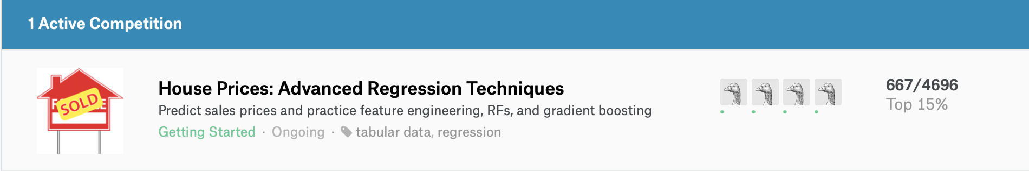
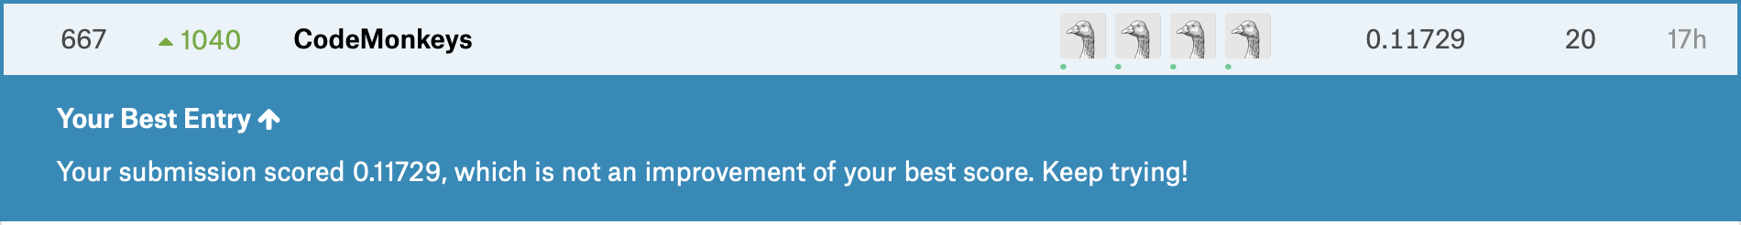
Our Best Ranking(Top 15%):
First of all, in the competition, our team ranks around 15%

Slide 3
1.0-3.0 Version:
1.0 version: - Only one adding feature “TotalArea”;
-Falsely using mean values to fill in the numeric attributes, e.g, the house has no garage,
but fill in the garage with the average value of this group(do group by first);
-One hot encoding;
-Linar Regression Model;
2.0 version: - Adding more features;
- Fill in the missing value with relatively correct method;
- One-hot encoding;
Linear regression model,Elastic Net Regression, Lasso Regression.
3.0 version: - Model Enhancement on the basis of 2.0 version;
- Add more features;
- Gradient Boosting Regression, Ridge Regression;
- Stack the models with relatively good performances together to realize the prediction.
Notes:
3 versions of works. In the first one, we add one feature, total and applied Linear Regression Mode. However there some invalid filling method here. In the second one, we added more features and correct the method to fill in the missing values. And use Elastic Net Regression, Lasso Regression to train the data. In the last one, we add more features and enhanced the models on the basis of the second. Finally we merge some models result to find out the best mining result.

Slide 4
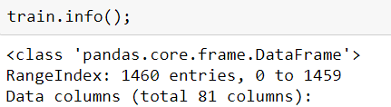
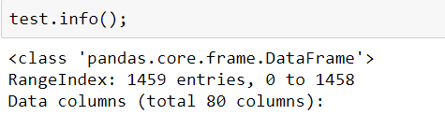

Data Description
Lets look at our work more specifically. To begin with we put the data in pandas dataframe to observed the data types, the number, the distribution and features of these data.

Slide 5
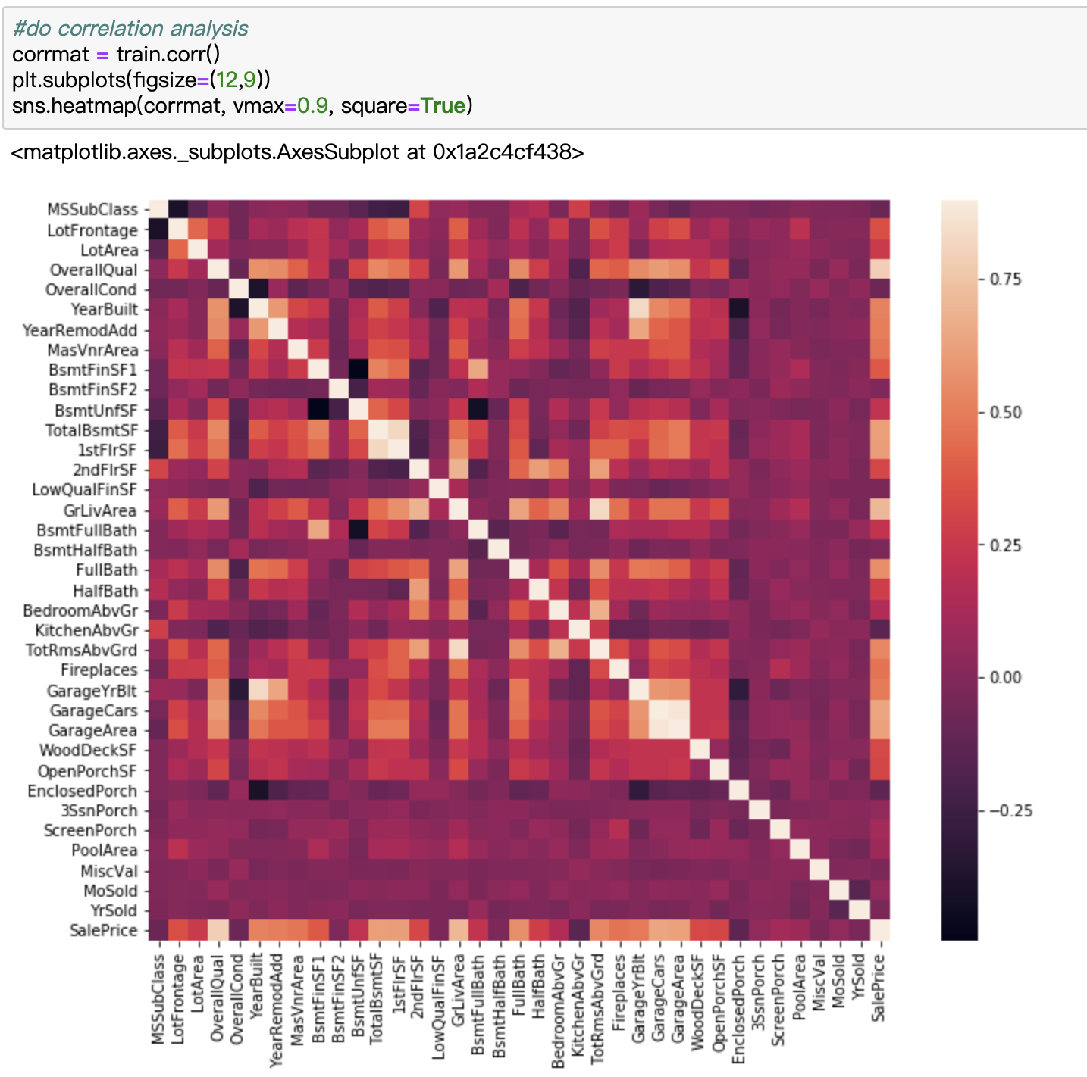
Correlation Analysis
Only Numerical values!
After that, we discussed how to find the outliers effectively. And Finding that only deleting outliers highly correlated with saleprice matters!
So we use function of corr to find out how features are correlated with SalePrice. As the heatmap showing, the red deeper, the correlation higher.
Btw, Correlation Analysis is only suitable for numerical values.

Slide 6
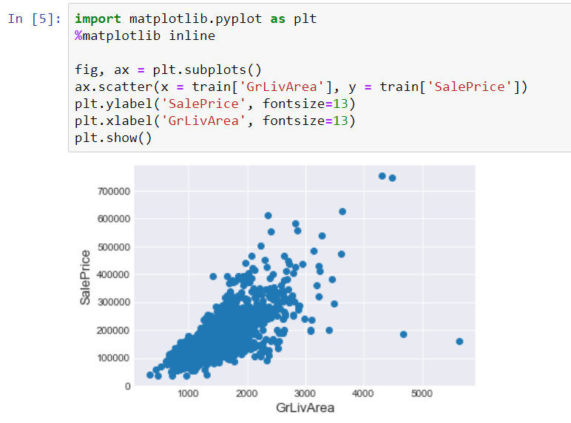
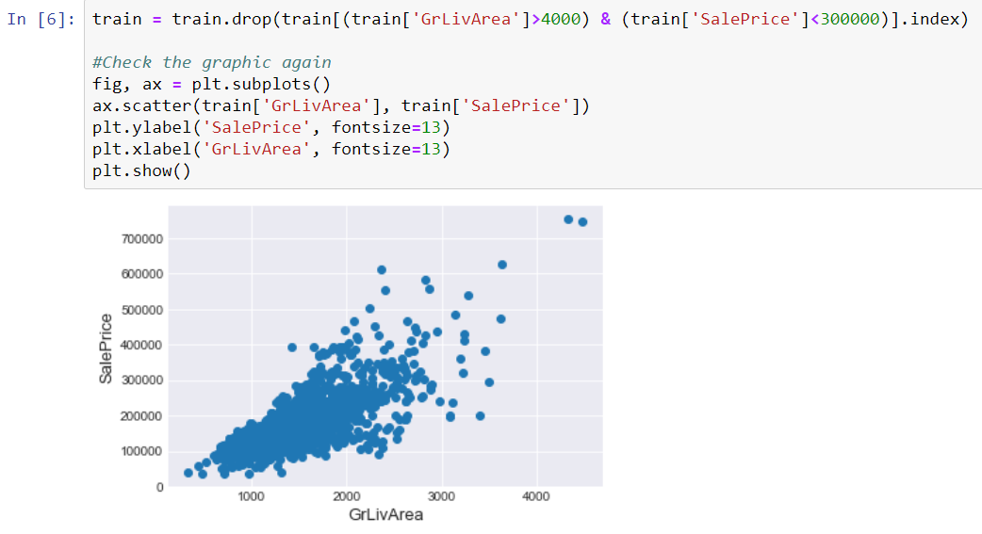
Discard Outliers --- e.g ‘GrLivArea’
Then, we choose five features based on Correlation Analysis to explore the outliers and to delete them. (the value of the five are larger than 0.5)
In the correlation between ground living area square feet and saleprice, We can see at the bottom right two with extremely large GrLivArea that are of a low price. These values are huge oultliers. Therefore, we can safely delete them.

Slide 7
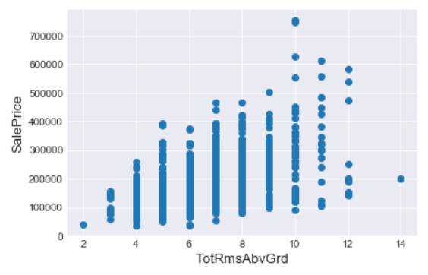
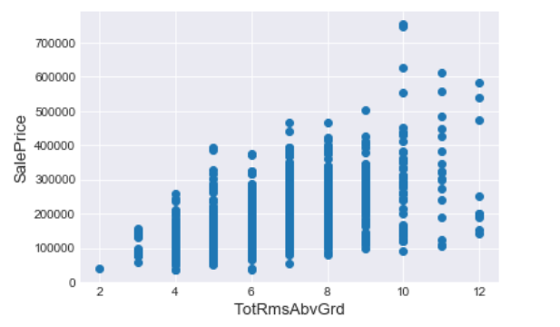
Discard Outliers---TotRmsAbvGrd
And for Total rooms above ground, we deleted this point.

Slide 8
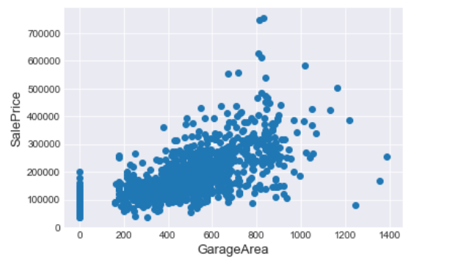
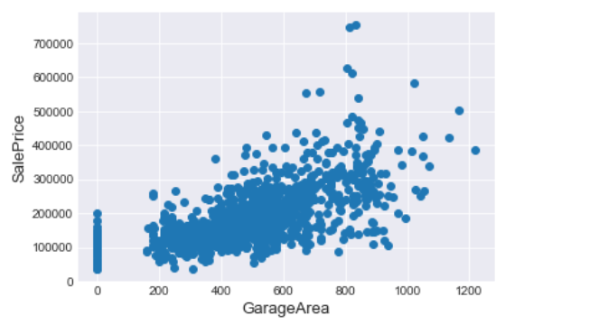
Discard Outliers---GarageArea
And for Size of garage, we deleted these three points.

Slide 9
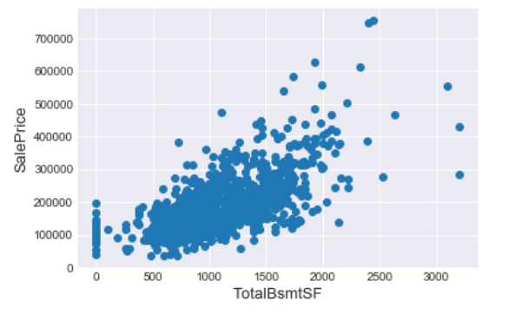
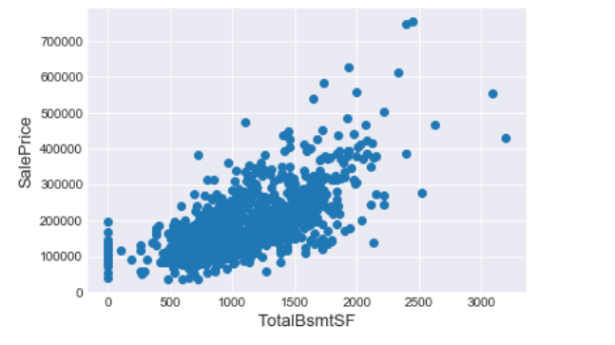
Discard Outliers---TotalBsmtSF
For Total square feet of basement area, we deleted this points.

Slide 10
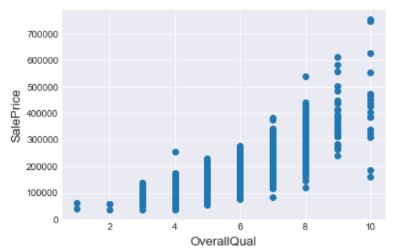
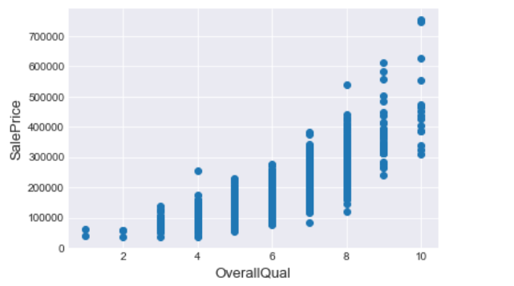
Discard Outliers---OverallQual
For Overall material and finish quality, we deleted these two points.

Slide 11
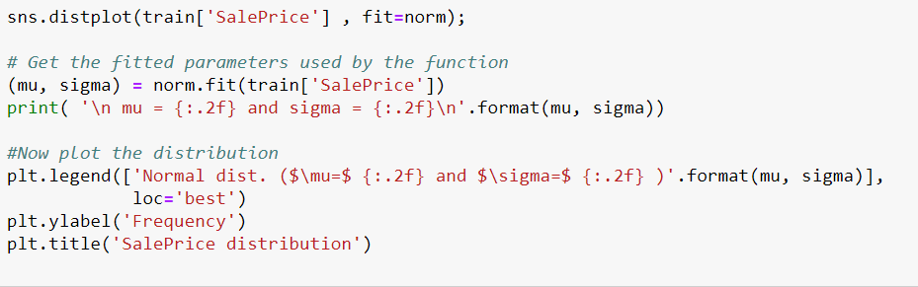
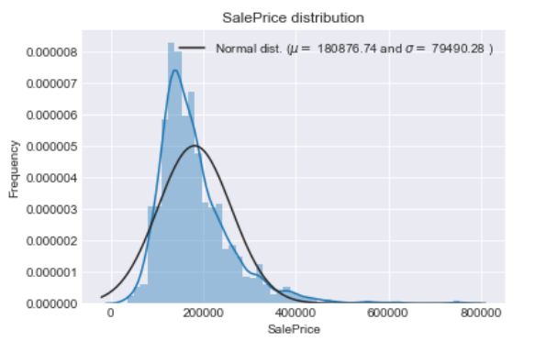
Skewness Adjustment
As linear models love normally distributed date so we analyzed how the saleprice distribute but found that it is right skewed

Slide 12
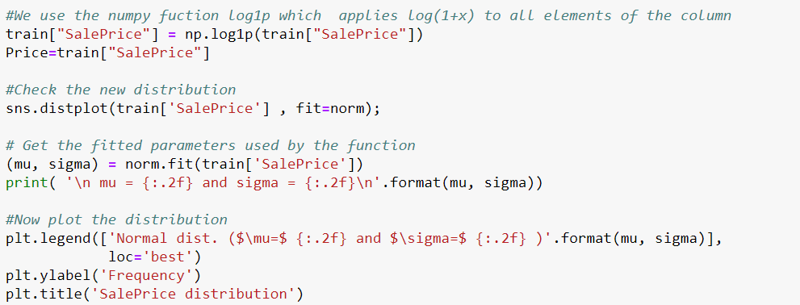
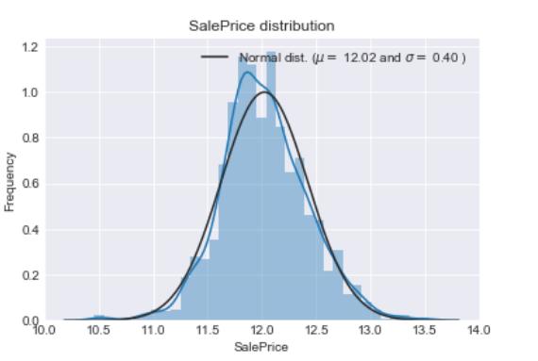
Skewness Adjustment
Remember converting back after prediction!
So we use Log-transformation to pull it at the center.
And there is one thing I have to mention that do Remember converting back after prediction!
Because at first time we forget to convert the normally distributed to the origional one we got very pool score.

Slide 13
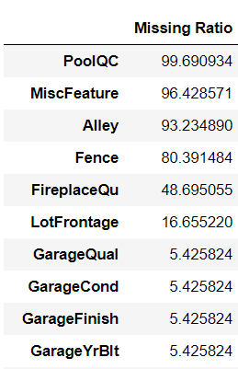
Filling In Missing Value -- Merge train & test
Calculate Missing Ratio
Then we try to find the missing value and to fill in them.
Here we use pandas function: point is_null divided by the length of all data to calculate the missing ratio

Slide 14
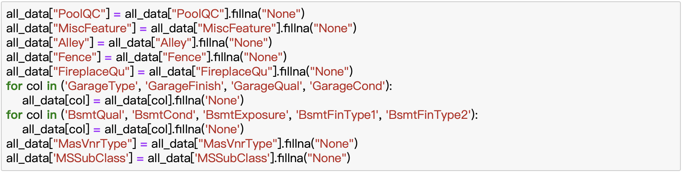
Filling In Missing Value --- Merge train & test
Fill in non-numeric value
NA has meaning: fill with “None”
Specifically, for non-numeric missing value, if missing value has meaning, we fill with “None”. For example, missing value of PoolQC means no pool so we fill with none

Slide 15
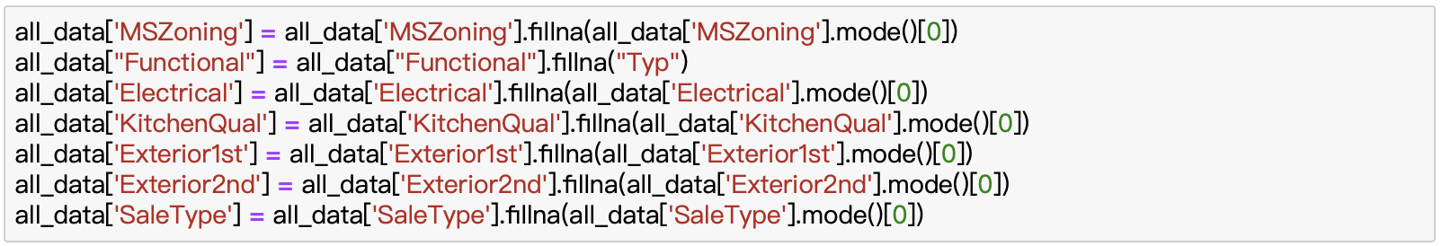
Filling In Missing Value --- Merge train & test
Fill in non-numeric value
NA has no meaning: fill with mode
and, for non-numeric missing value, if missing value has no meaning, we fill with mode.

Slide 16
Filling In Missing Value --- Merge train & test
Fill in numeric value
Group by → fill with median
The house has no garage or no basement, its numeric values will be filled with 0:
and, for numeric missing value, if missing value has no meaning, we fill with median and if it has mean we fill with 0. For example, here, a house has no basement, its numeric values will be filled with 0.

Slide 17
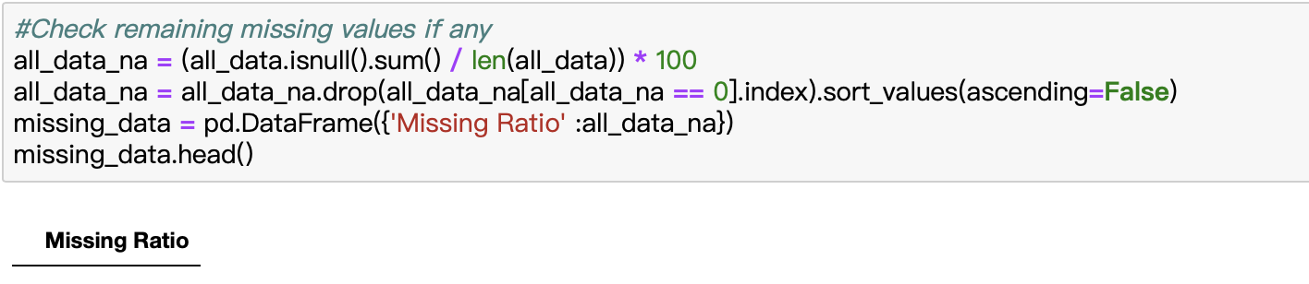
Filling In Missing Value --- Merge train & test
Re-check Missing Ratio
Lastly we check the missing value again to make sure we add all the missing values.

Slide 18
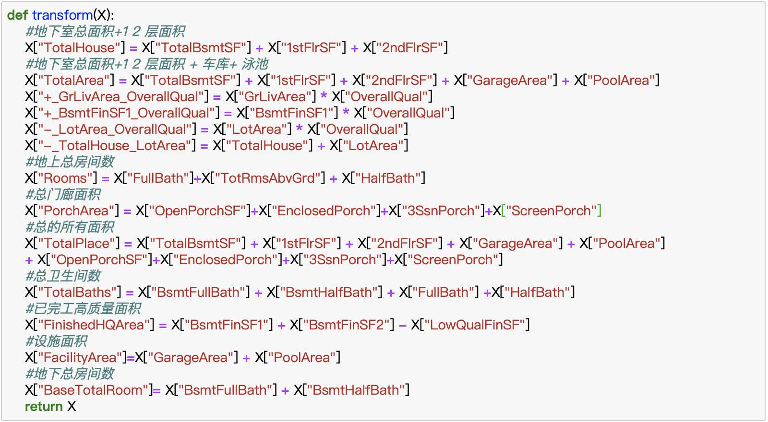
Feature Engineering:
Furthermore, in feature engineering period, we added 13 more features. For example, Here we regard the sum of Unfinished square feet of basement area, First Floor square feet and second Floor square feet as total house square. Similar ideal can be found at the remaining 12 features

Slide 19
One-hot Encoding:
Data after adding features:
Data after one-hot encoding:
To make the data fit our models and make our models more efficiently, we use one hot encoding to convert the categorical values to the continuous or numeric values.
Specifically, we use pandas function get dummies here to realize.

Slide 20
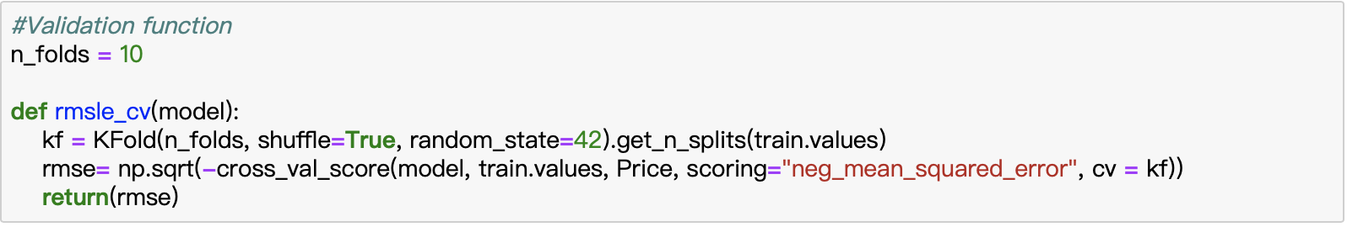
Train Model:
Cross Validation & Definition of RMSE
Finally, we start to train the model. Before training, we write the same evaluation method of this competition, Root-mean-square deviation. As we all know, it is a frequently used measurement of the differences between values predicted by a model and the values observed.
In the method, we use 10_folds cross validation.

Slide 21
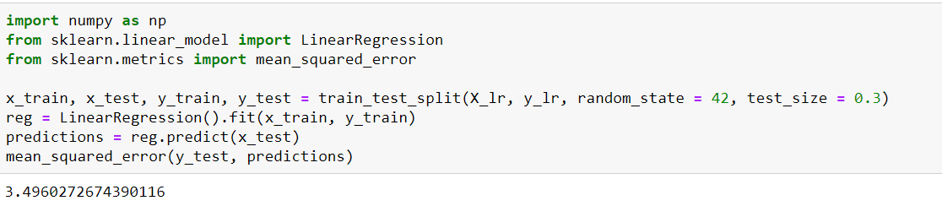
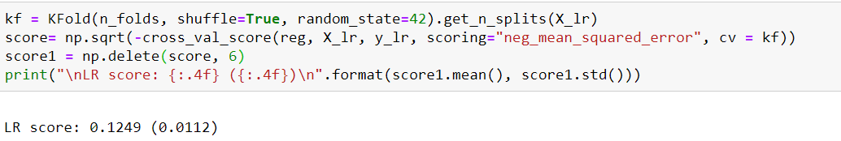
Train Model: 1. Linear Regression Linear Regression without normalizatio n feature scaling: 2. Measure Metrics --- mean_squared_error & RMSE
Our first model is linear regression, which can be imported from sklearn. The result is 0.12sth, just so so. So we try to improve it by using normalizing the feature.

Slide 22
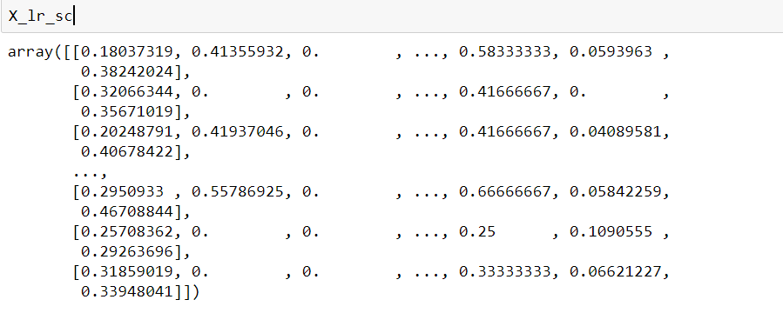
Train Model: 1. Linear Regression
Linear Regression AFTER normalization feature scaling:
2 Measure Metrics --- mean_squared_error & RMSE

Slide 23
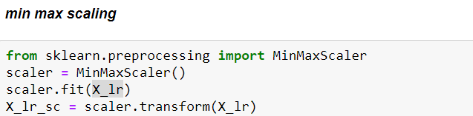
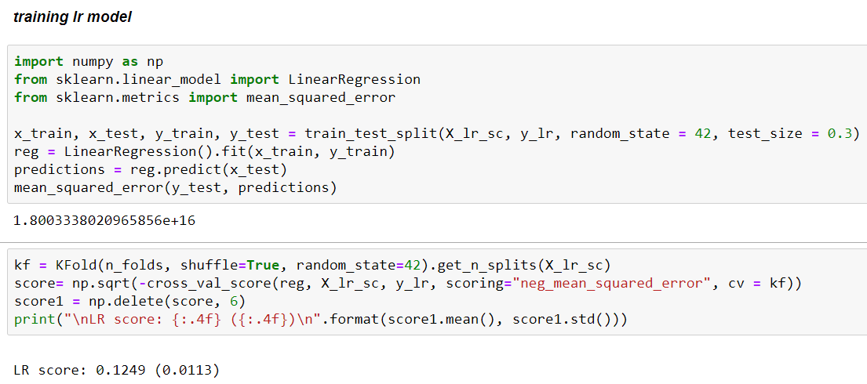
Train Model: 1. Linear Regression
Linear Regression AFTER normalization feature scaling:
2 Measure Metrics --- mean_squared_error & RMSE
As we can see, mean_squared_error DOWN but the score didn’t change much.
So we continued to try other models.

Slide 24
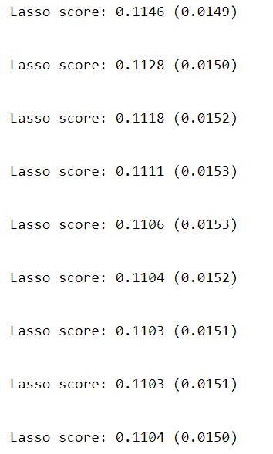
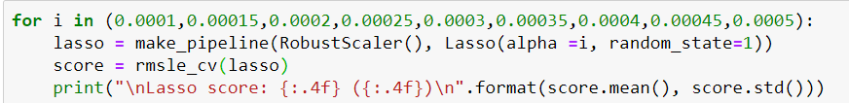
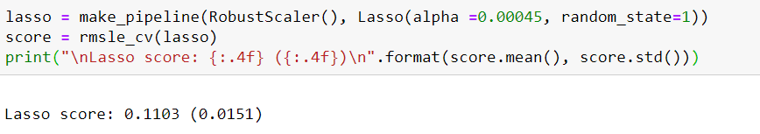
Train Model: 2. Lasso Regression
Our second model is lasso regression. We wrote a loop to check the scores of different parameters. The best score is 0.1103

Slide 25
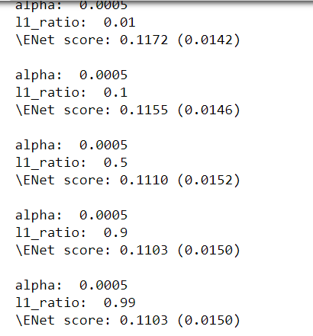
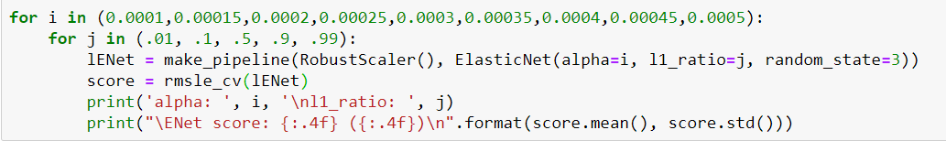
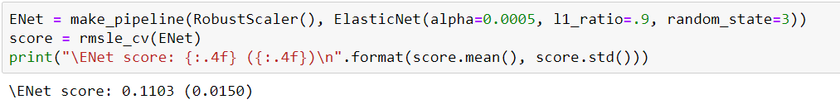
Train Model: 3. Elastic Net Regression
Our third model is Elastic Net Regression. The best score is 0.1103

Slide 26
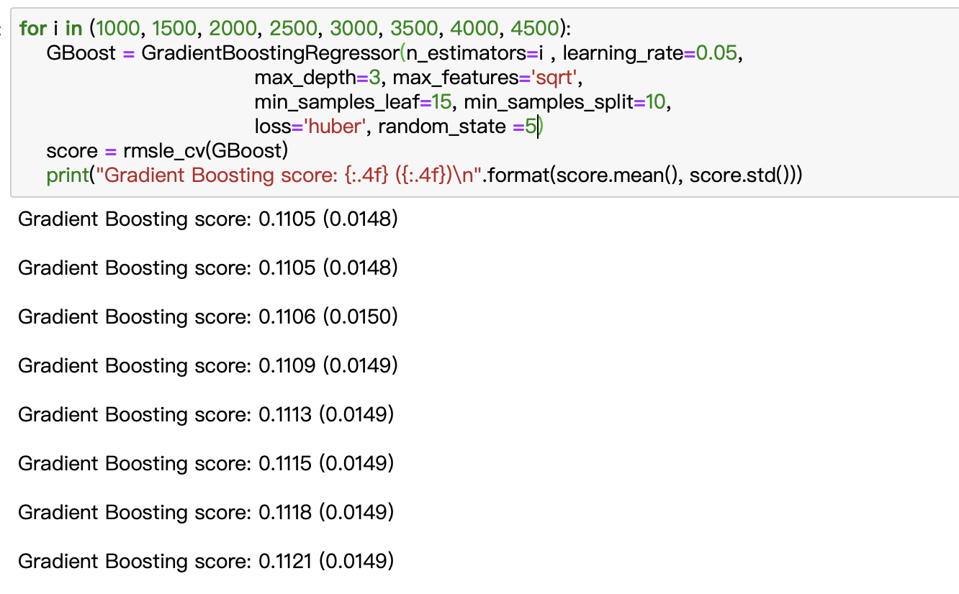
Train Model: 4. Gradient Boosting Regression
Our forth model is Gradient Boosting Regression. The best score is 0.1105

Slide 27
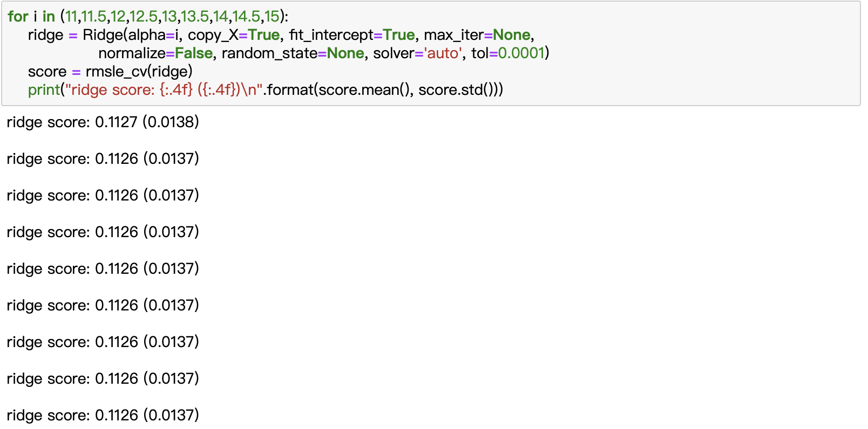
Train Model: 5. Ridge Regression
Our fifth model is ridge Regression. The best score is 0.1126

Slide 28
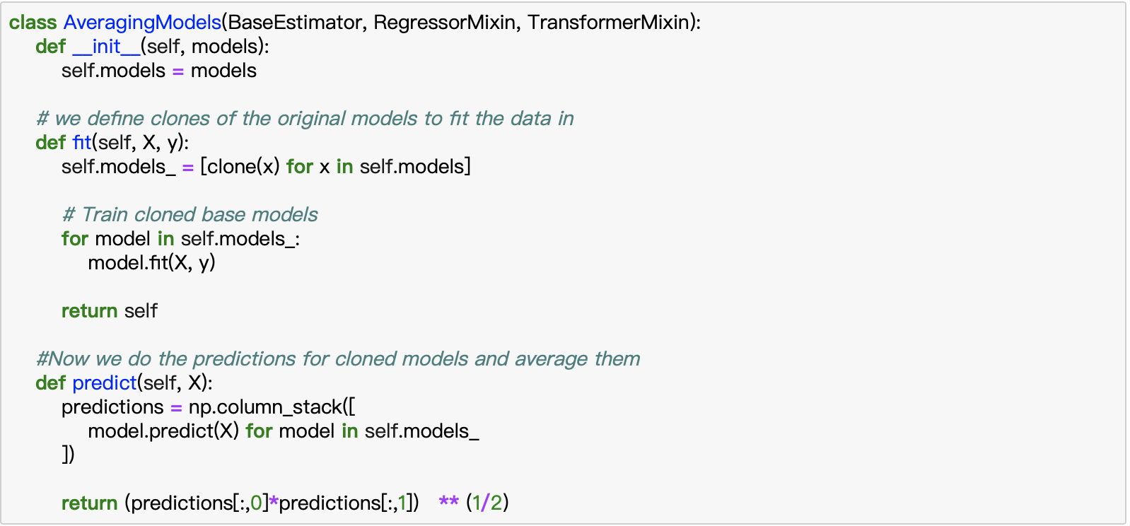
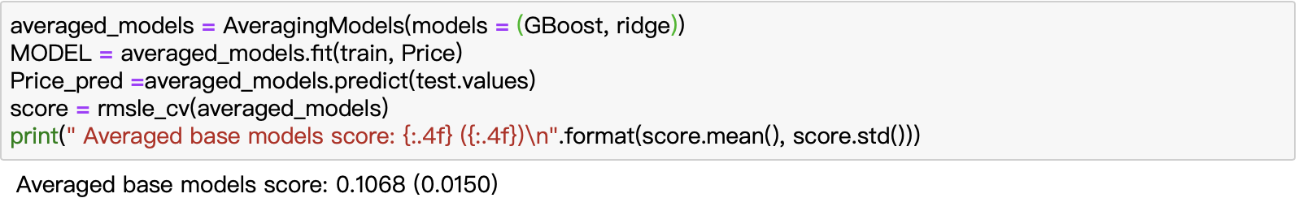
Stack Model
Finally, considering the performance of these models, we choose Ridge Regression and Gradient Boosting Regression with the best parameters to build the stacked model.
To be mentioned, there are 2 ways to stack the models. The first one is adding two results and divide by two.
The second one is multiplying the two results and then square root.
And the second one performed well in our result.

Slide 29
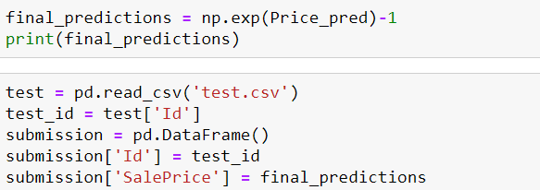
Predict test data and output .csv file
Remember converting normalization form back after prediction!
Finally, as mentioned before, we convert the saleprice to original one.
Then write the result to csv file, upload, finish.

Slide 30
Thanks!

